Slide 1
Report of STA323
Project 2
ZHANG Chi
12110821

Slide 2
CONTENTS
Question and
answering system
Startup Analyses
Snowflake
Paper Reading
Spark SQL

Slide 3
Question and
answering system
01

Slide 4
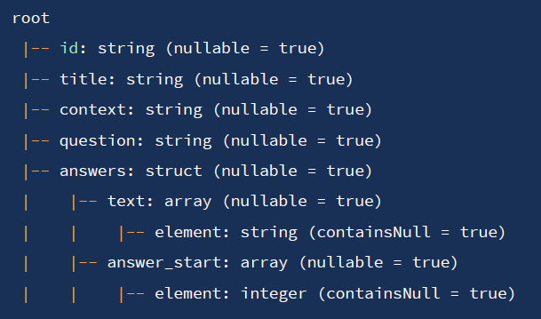
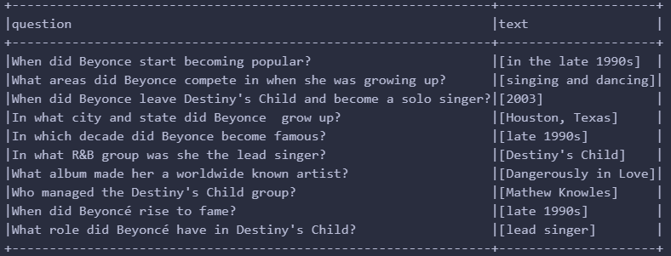
Load and preprocess data --- quick look
schema
original data with columns question and text

Slide 5
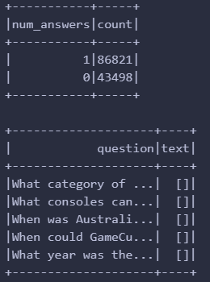
Load and preprocess data --- unanswerable questions
inspect how many unanswerable
questions it contains
some records of unanswerable question
-- > answers are empty

Slide 6
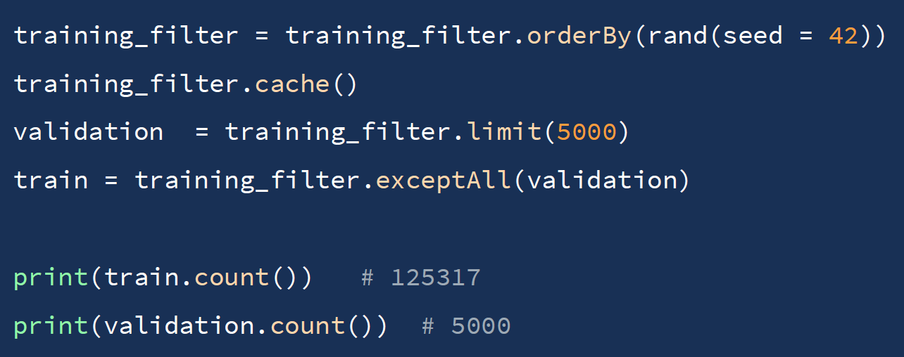
Load and preprocess data --- split training data
randomsample() can not designate the specific number of samples to be selected.
sample() is not used as it can not promise to choose the number we give
shuffle()
select the first 5000 samples

Slide 7
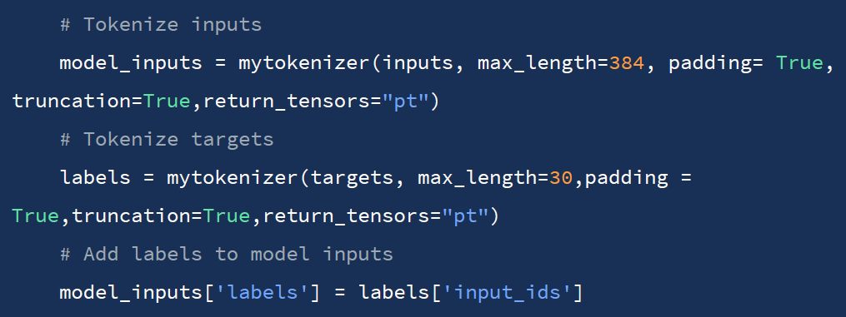
Ray Tune --- load data
The whole training was performed on openbayes with RTX4090*2, after debugging in the course server with only CPU (using additional training and validation datasets with only 20 samples).
Data Reading and Preprocessing: load_and_preprocess_datasets()
Define a logic that checking if there are preprocessed datasets existing and the pickle data can be loaded directly if true, otherwise the programme will process it and save to the designated directory passed in config

Slide 8
Ray Tune --- Training Setup
Define a function train_func() that calls load_and_preprocess_datasets()
Loads the model and tokenizer, sets up training arguments, and trains the model. This function will be used by Ray Tune for hyperparameter tuning

Slide 9
Ray Tune --- Hyperparameter Tuning
tune_transformer()：designed to perform hyperparameter tuning for a transformer-based model using Ray Tune. The function defines the configuration for the tuning process, sets up a scheduler, and reports the results of the tuning trials.
tune_run()： is the most important function, containing the whole tunning processes by calling train_func for each trial. The tune.with_parameters(train_func) specifies the training function used for each trial
metric="eval_loss" and mode="min" indicate that the evaluation loss is the metric to be minimized. resources_per_trial={"cpu": 19, "gpu": 2} allocates 19 CPUs and 2 GPUs per trial, which can be adjusted as needed.
config=tune_config passes the predefined tuning configuration.
num_samples=3 sets the number of trials to be conducted.
storage_path=args.local_dir specifies the local directory to store tuning results
keep_checkpoints_num=3 limits the number of checkpoints saved during the tuning process.

Slide 10
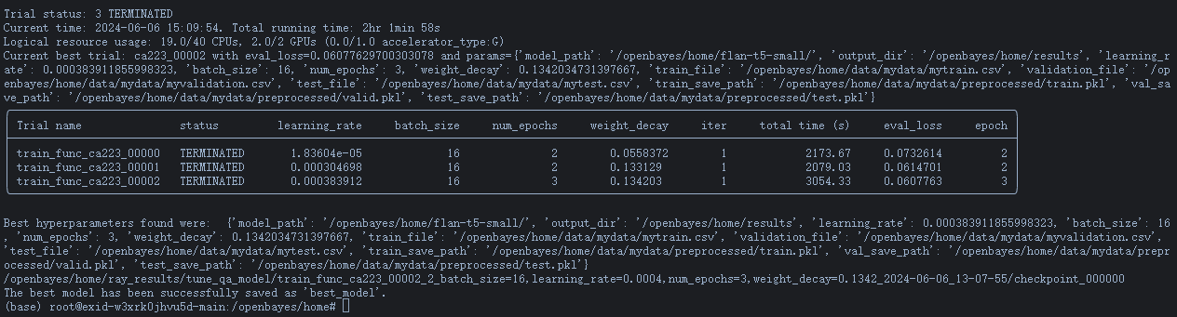
Ray Tune --- bash script
python Q1_2.py
--model_path ${model_path}
--bestmodel_dir $best_model_dir
--train_file $train_file
--local_dir $local_dir
--validation_file $validation_file
--traindata_process_save_path $traindata_process_save_path
--test_file $test_file
--valdata_process_save_path $validationdata_process_save_path
--output_dir $output_dir
--testdata_process_save_path $testdata_process_save_path

Slide 11
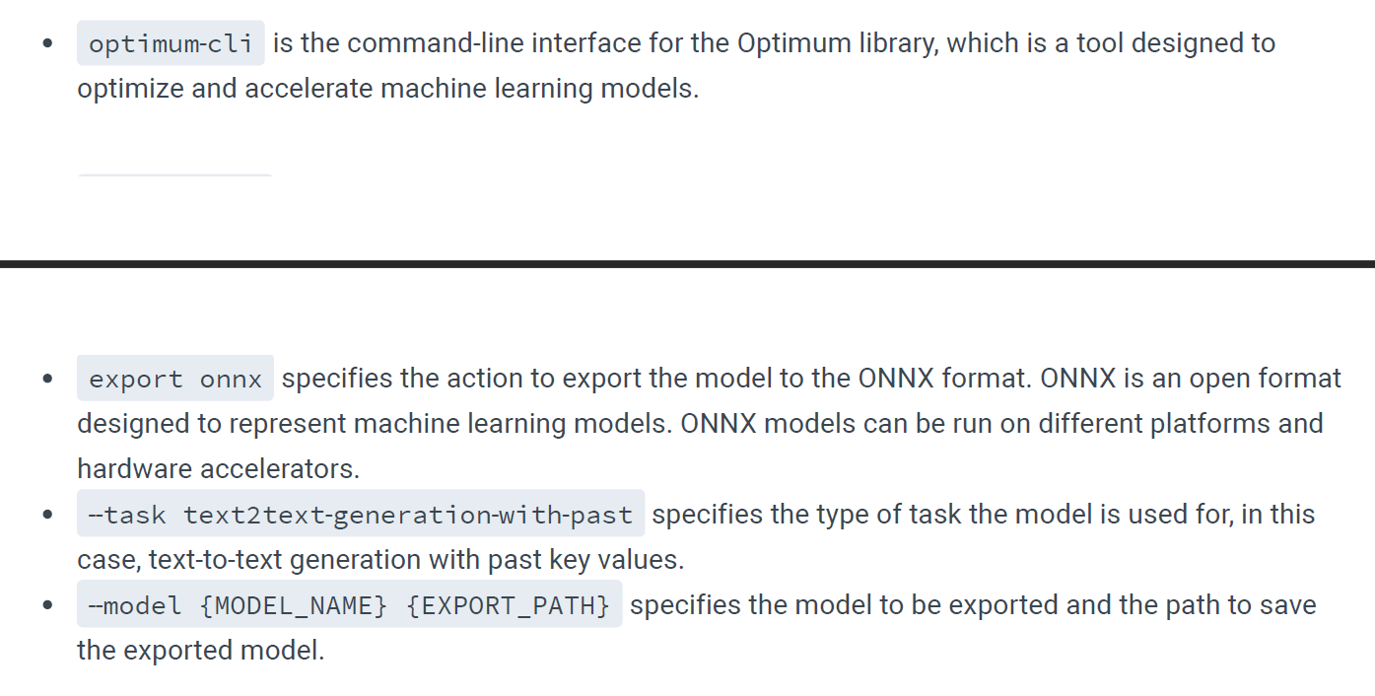
deploy the QA model --- convert to sparknlp model
transform the current hugging face model to the sparknlp model
!optimum-cli export onnx --task text2text-generation-with-past –model {MODEL_NAME} {EXPORT_PATH}

Slide 12
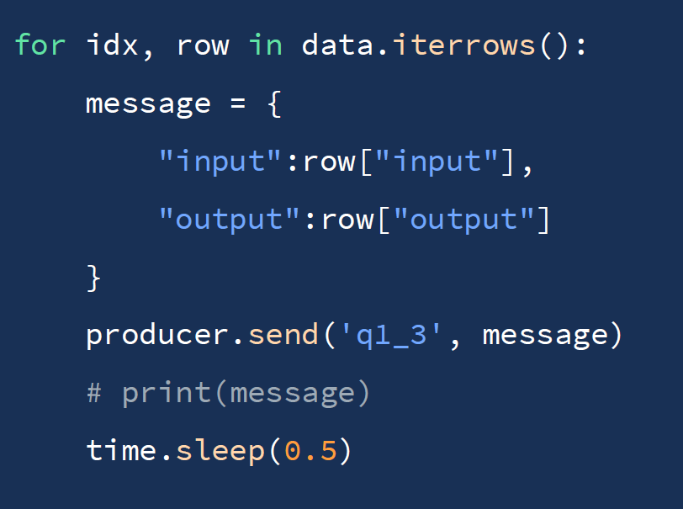
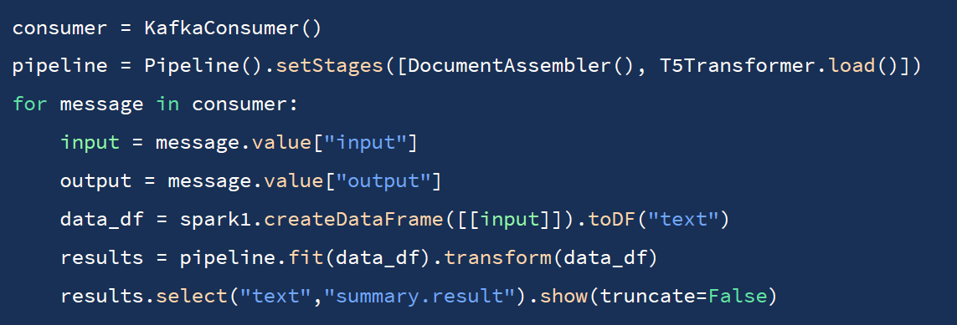
deploy the QA model --- Kafka
producer: decide the topic and the message to be sent
consumer

Slide 13
RAG
The proliferation of RAG architectures can be divided into 3 stages:
Naive RAG, which employs a straightforward approach with separate retrieval and generation modules;
Advanced RAG, characterized by sophisticated techniques that improve the integration and performance of these modules;
Modular RAG, offering a flexible, component-based design that allows for specialized customization and continuous enhancement.

Slide 14
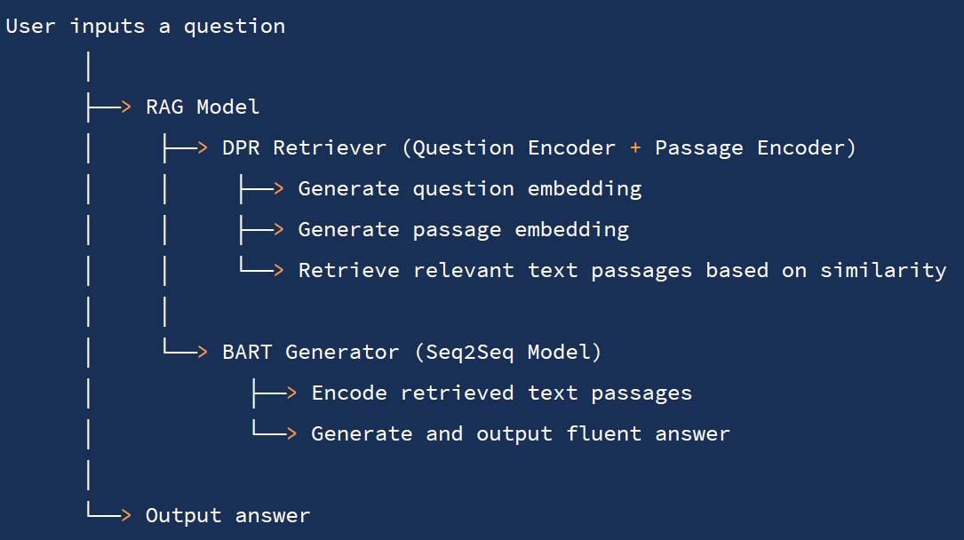
RAG --- Naive RAG
This RAG model facilitates ODQA by integrating a DPR retriever and a BART generator. When a user inputs a question, the DPR's question encoder generates an embedding, while the passage encoder creates embeddings for text passages in the knowledge base. The system retrieves relevant passages based on similarity scores and feeds them into the BART generator, which then produces an answer.

Slide 15
Startup Analyses：
Snowflake
02

Slide 16
Snowflake - A Brief Introduction
Founded in 2012 in Bozeman, Montana
Mission: To make data accessible, affordable, and impactful for all
Growth: Rapid expansion and innovation since inception
2014: Launch of first-generation product
Series B Funding: $26 million secured under CEO Bob Muglia
2017-2019: Gartner recognition, moving to a leader position
2020 IPO: Stock price doubled on the first day, marking a successful debut
2023 Revenue: $2.1 billion, a 69% increase from the previous year

Slide 17
Product- Cloud-Native Data Warehousing
High Performance: Optimized for speed and efficiency
Scalability: Elastic scaling to meet fluctuating demands
Ease of Use: User-friendly interface and operations
Features - Unique Architecture
Independent Scaling: Storage and compute resources can be scaled independently
Data Exchange: Modern feature for seamless data sharing and collaboration
Compatibility: Supports multiple data formats and integrates with various tools

Slide 18
SWOT Analysis
Strengths - Marketplace & Business Model
Innovative Marketplace: Data-sharing platform connecting 448 providers
Flexible Pricing: Consumption-based model, allowing for cost optimization
Multi-Platform Support: Choice of AWS, Azure, and Google Cloud for data storage
Opportunities - Strategic Positioning
AIGC Growth: Capitalizing on the demand for data-intensive solutions
Market Expansion: Cloud-based data warehousing and analytics projected to grow
Future Trends in the Market
Data-Driven Decisions: Increasing reliance on data analytics
AI & ML Integration: Leveraging technology for deeper insights
Challenges - Competitive and Regulatory
Competitive Pressure: From established tech giants offering similar solutions
Regulatory Scrutiny: Navigating data security and privacy regulations

Slide 19
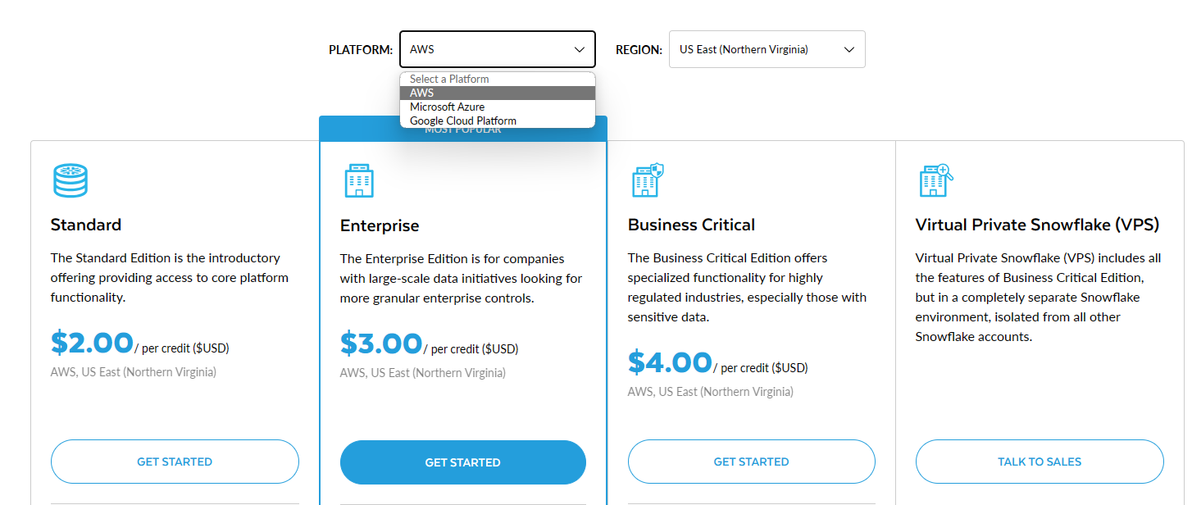
Strengths - Marketplace & Business Model

Slide 20
Learning from Public Talks or Interviews of the Entrepreneur/Company
From public talks and interviews,it is evident that Snowflake's leadership emphasizes customer-centric innovation and a commitment to staying at the forefront of cloud data technology.
The company's focus on building a strong partner ecosystem and expanding its platform's capabilities to meet diverse customer needs is a strategic approach to maintaining its competitive edge.

Slide 21
Paper Reading：
Spark SQL
03

Slide 22
Spark SQL: Relational Data Processing in Spark
Problem Statement
Traditional frameworks are inefficient when both relational and procedural processing is required.
The need for versatile tools that can handle diverse data sources and workloads.
Related Works
Early projects like Apache Hive and Shark aimed to enhance SQL capabilities for Hadoop and Spark.
Optimization techniques and new frameworks like Apache Flink have contributed to the development of Spark SQL.

Slide 23
Spark SQL: Relational Data Processing in Spark
Core Contributions
DataFrame API: A high-level, declarative syntax for relational operations on distributed data.
Catalyst Optimizer: An extensible optimizer leveraging Scala for sophisticated query optimization and support for various data sources and functions.
Experiments Design and Results
Benchmarks: TPC-DS and real-world workloads from an Internet company.
Metrics: Execution time, query optimization effectiveness, scalability.
Findings: Spark SQL outperforms systems like Shark and Hive, demonstrating the benefits of a unified data processing system.

Slide 24
Spark SQL: Relational Data Processing in Spark
Discussion
Spark SQL's unified interface provides both high performance and flexibility.
The DataFrame API and Catalyst optimizer are key to its efficiency and scalability.
Future Directions
Enhancing Spark SQL's usability for a broader audience, including less technical users.
Case-by-case examples to illustrate Spark SQL's application in various scenarios.

Slide 25
Project 2 Report of STA323
THANKS
ZHANG Chi
12110821

